Slide 1

BPCI Twitter Data Analysis and Monitoring Demonstration
September 27, 2019

Slide 2
What We Have Done
Extracted data on past BPCI tweets
Conducted exploratory analysis based on historical data to inform what to monitor going forward
Determined feasibility/usefulness of different analyses
Created draft GUI for monitoring tool

Slide 3
Meeting Purpose
Present what we found in historical data
Brainstorm what to monitor for going forward
Talk next steps for monitoring tool

Slide 4
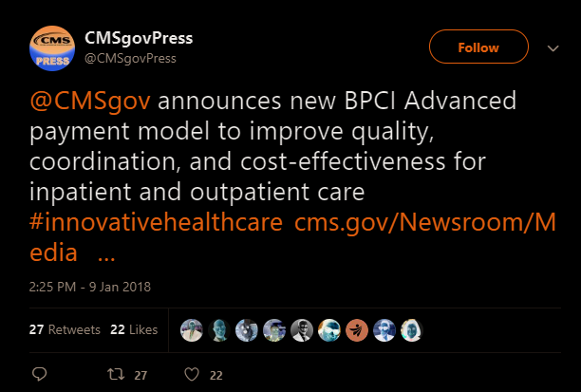
Historical Twitter Data
Want to extract data on all tweets related to BPCIA
“BPCIA related” tweet definition:
Dated Jan 9,2018 - Present
Text contains “BPCI Advanced” or variation
Found ~2,700 tweets in past 21 months

Slide 5
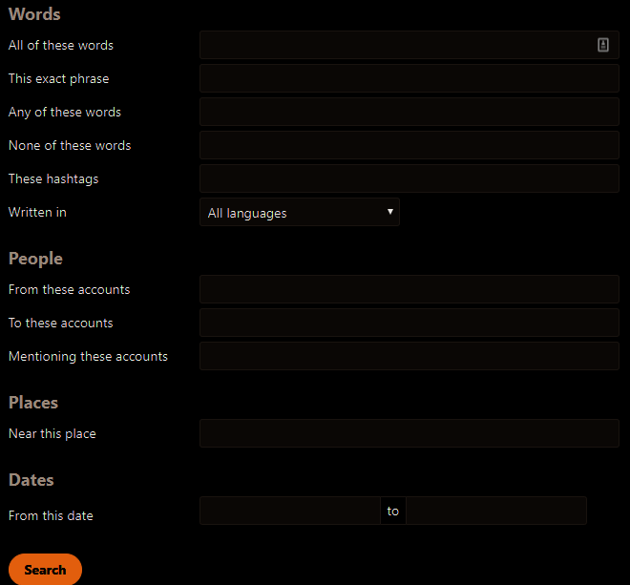
Tweet Extraction
Can extract tweets based on any of Twitter’s advanced search parameters
Current list of keywords:
BPCIAdvanced
“BPCI Advanced”
BPCIA
BPCI-A
"Bundled Payments for Care Improvement–Advanced"
"Bundled Payments for Care Improvement Advanced"
Notes:
Look for prolific usernames for main influencers, use get old tweets to harvest their tweets and look for additional keywords. Look at using fuzzy matching; look for likely typos in the spellings. Look at fuzzywuzzy.
censored geographic and other information

Slide 6
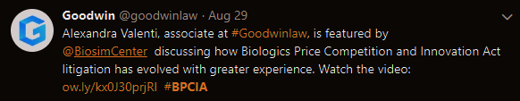
Tweet Extraction
Filtered out some false positives
There is another BPCIA: Biologics Price Competition and Innovation Act of 2009
Used some keywords to filter out those tweets

Slide 7
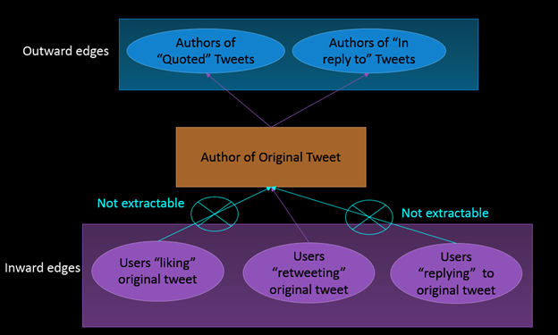
Tweet Extraction
Limitations to extracting related content

Slide 8
General Monitoring Tool
On demand, the tool will easily:
Rerun extraction to retrieve any new tweets related to BPCIA
Update any of the analyses we present with new data
Update the analysis displays in the GUI

Slide 9
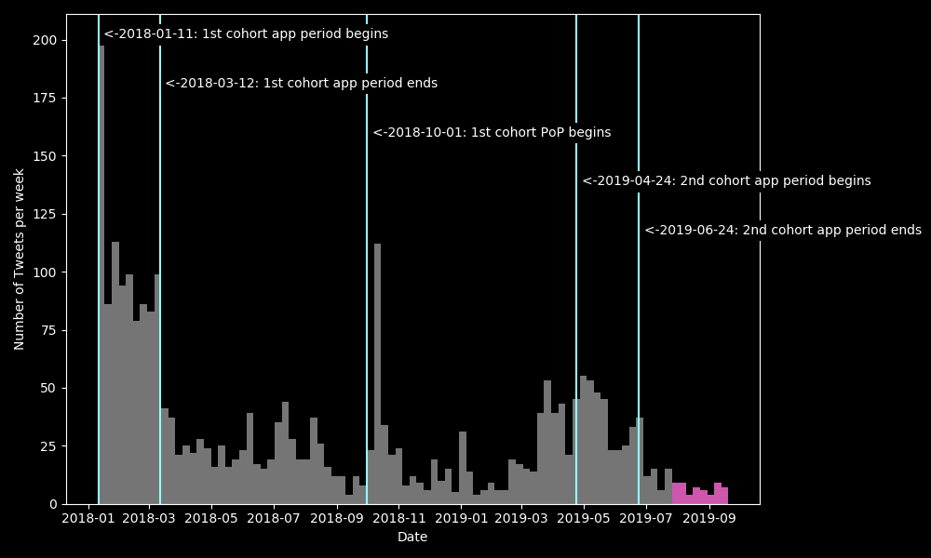
General Monitoring Tool
Tool can highlight new data

Slide 10
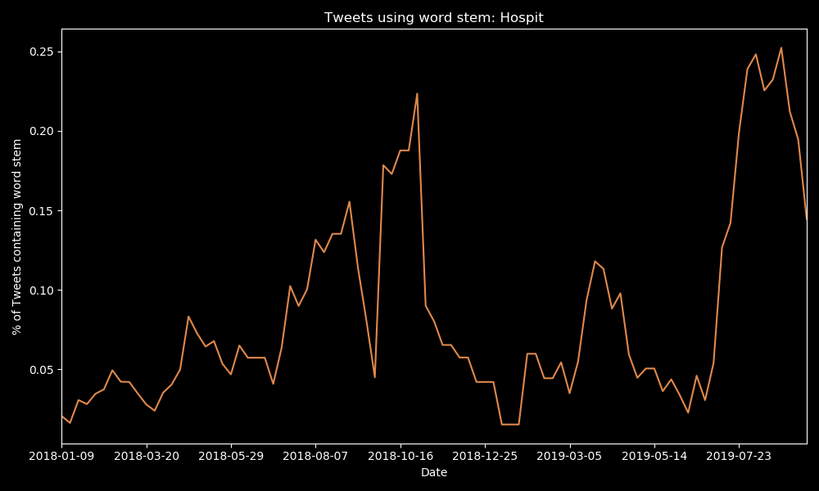
General Monitoring Tool
Tool can flag anomalous recent behavior differing from past trends

Slide 11
Areas of Analysis
Reaction Timing/Speed
Level/Variety of Engagement
Geographic Analysis
Content Analysis

Slide 12
Area 1. Reaction Timing/Speed

Slide 13
Area 2. Level/Variety of Engagement

Slide 14
Area 3. Geographic Analysis
Analysis Summary
Limited tweet geolocation data
Sophisticated geospatial analysis not really feasible
580 of 2723 (21%) tweets had geolocation data
Mostly U.S. eastern seaboard cities

Slide 15
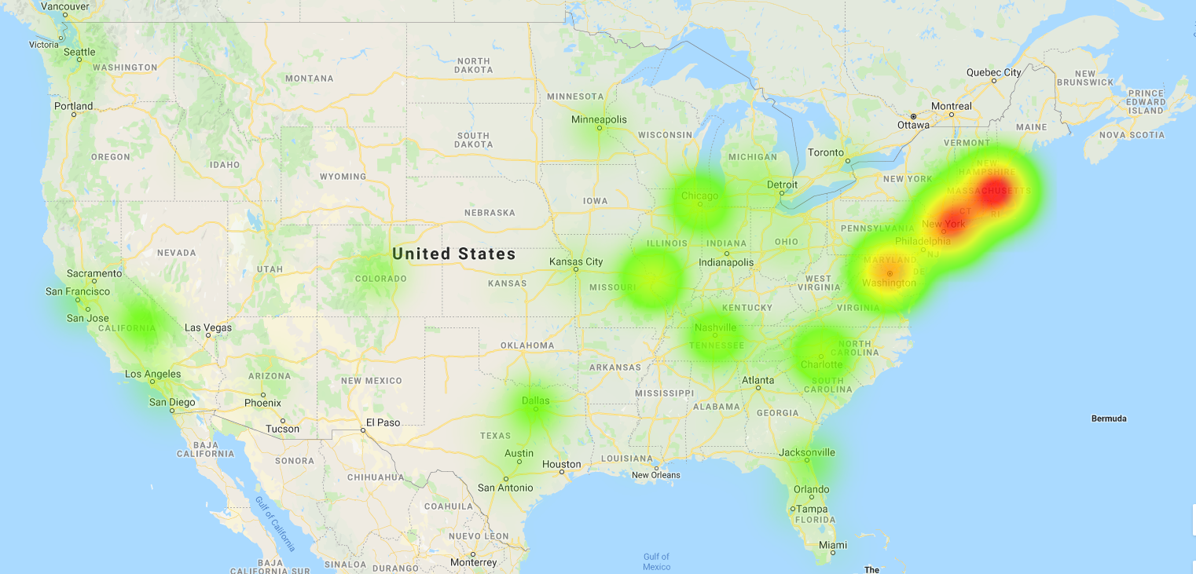
Area 3. Geographic Analysis
Notes:
List things that would make this look different for Evan’s team.
Can you identify transmission channels/influencers? Different by geography?
Think about reference anchors for new analyses ppl haven’t seen yet. Think about looking at some of the other similar models and comparing results to this.
Make sure other models are not causing false positives in this one.

Slide 16
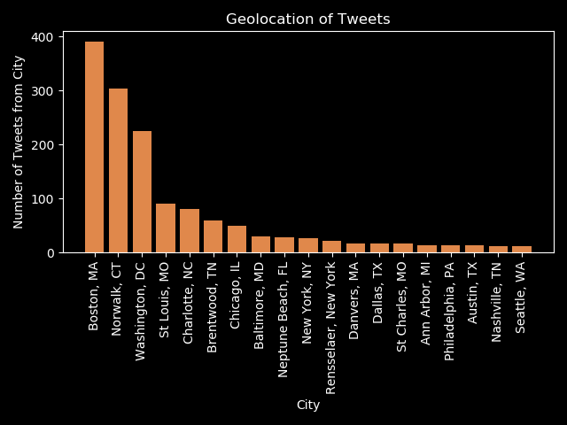
Area 3. Geographic Analysis

Slide 17
Area 4. Content Analysis
Analysis Summary
Most were advertisements for articles/webinars about BPCIA, but didn’t contain substantive or sentimental language
As a result, NLP methods produced somewhat noisy and difficult to interpret results
Scattered substantive discussion of issues in tweets identified in sentiment analysis. Automated detection of issues difficult.

Slide 18
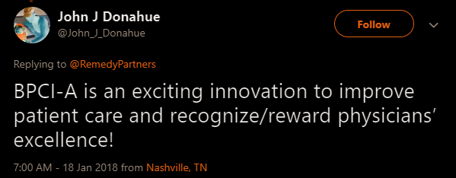
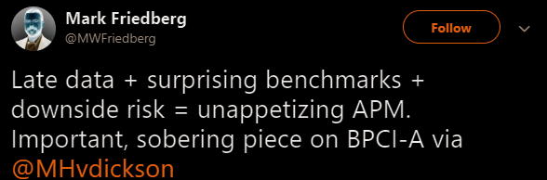
Area 4. Content Analysis
Scored each tweet’s sentiment positive/ neutral/ negative sentiment from 0-1. Sample extremes:
Can sort tweets by sentiment score in GUI. There is some noise in scores though.

Slide 19
Area 4. Content Analysis
Positive tweets tend to be general banalities
Negative tweets do point out some issues, and are worth monitoring
May overlap with media analysis, as many are linking to articles.
Some issues found in negative tweets…

Slide 20
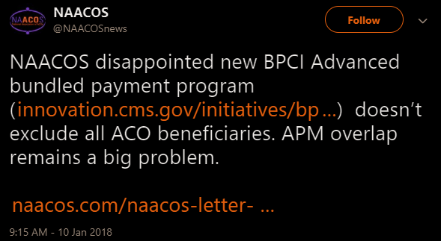
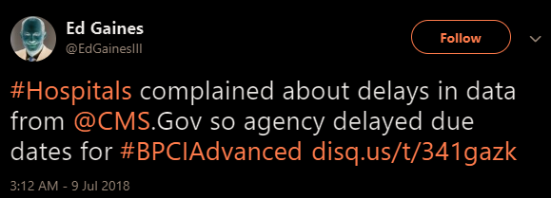
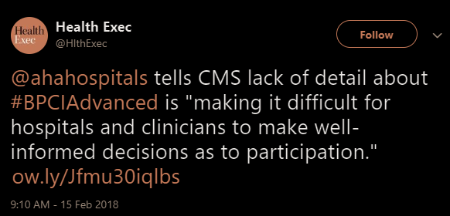
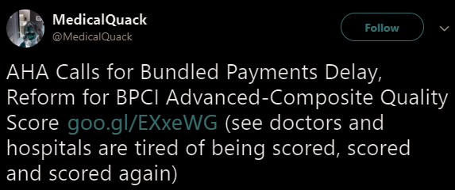
Area 4. Content Analysis

Slide 21
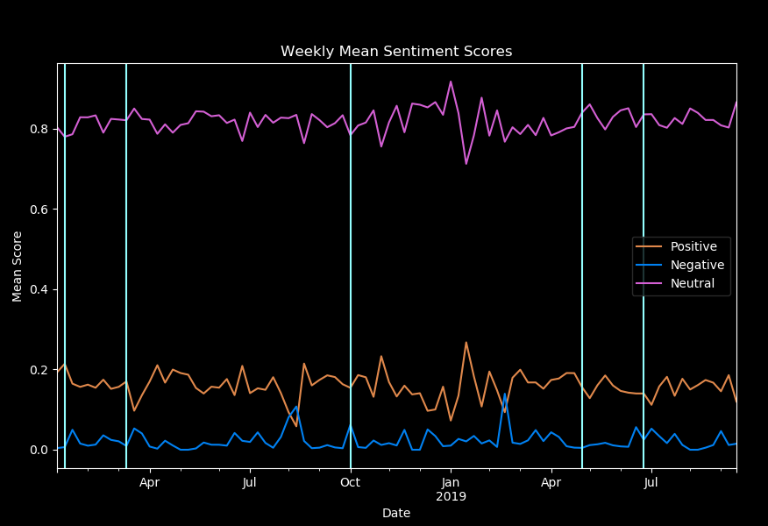
Area 4. Content Analysis
Tweet sentiment trends:
Fairly steady
Mostly neutral
Nothing particularly striking, but could be worth keeping an eye on
Notes:
Preprocessing of time series data required; look at removing cyclical patterns/decomposition.

Slide 22
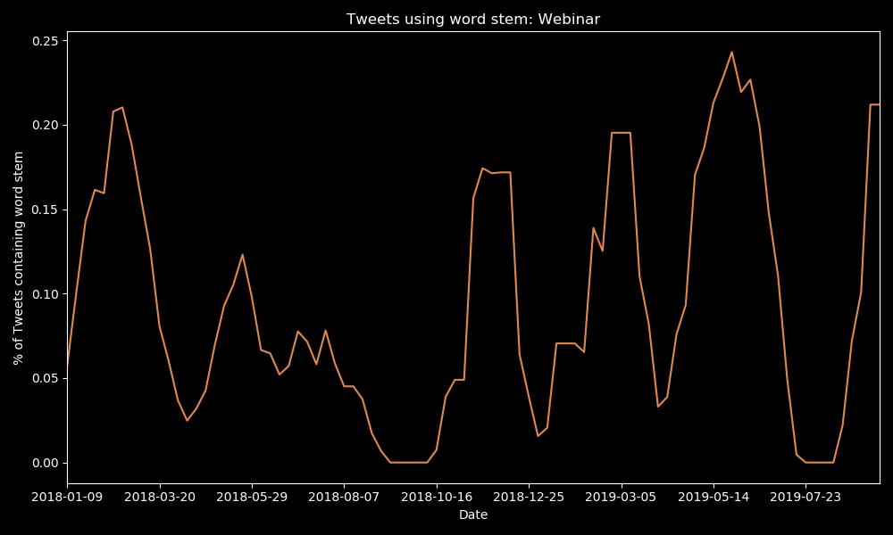
Area 4. Content Analysis
Can analyze word use trends over time, but often noisy

Slide 23
Area 4. Content Analysis
Also ran a few different topic models on tweet text to extract topics
Was not able to extract meaningful topics from the text
Likely due to lack of substantial discussions in tweets

Slide 24
Questions/Discussion

